Slide 1


Team Details
Team name:
Team leader name:
Problem Statement: Smart Supply Chains

Slide 2
Brief:
ETA Shield is a Next.js 16 web application designed to empower logistics professionals with preemptive disruption detection and dynamic route optimization. It allows users to input shipment details and identified disruptions to instantly receive a revised ETA, a detailed impact assessment, and a draft communication for stakeholders. By leveraging the Gemini AI model, the system analyzes complex transit data to mitigate cascading delays and enhance supply chain resilience, offering real-time intelligence in a minimalist, intuitive interface.

Slide 3
Opportunities:
• Differentiation
• The tool differentiates itself by offering immediate, AI-driven insights into complex supply chain disruptions, moving beyond reactive reporting to proactive problem-solving. Its minimalist UI focuses entirely on critical information, reducing cognitive load and enhancing user experience in high-stakes situations.
• Problem Solving Approach
• ETA Shield addresses the critical issue of reactive disruption management by employing Gemini AI to simulate scenarios and predict outcomes. It provides actionable intelligence, allowing users to make data-backed decisions on route adjustments and stakeholder communication before minor issues escalate into major crises.
• USP
• Its unique selling proposition is the combination of AI-powered predictive analytics for supply chain disruptions with a "maximum reduction" minimalist UI, offering critical insights with unparalleled clarity and speed, specifically for ETA recalculation and impact assessment.

Slide 4
Features:
• AI-Powered ETA Recalculation: Instantly revises ETAs based on disruption type, severity, and cargo criticality.
• Detailed Impact Assessment: Provides breakdown of delay causes and downstream effects on operations.
• Automated Stakeholder Communication: Generates a concise, three-sentence email for timely updates.
• Minimalist User Interface: Clean, focused design emphasizing essential information and ease of use.
• Responsive Design: Ensures usability across various devices (desktop and mobile).

Slide 5
Technologies:
• Frontend Framework: Next.js 16 (App Router)
• Language: TypeScript
• Styling: Tailwind CSS with custom CSS variables
• Icons: Lucide React
• AI Integration: Google Gemini-2.5-Flash via server-side API

Slide 6
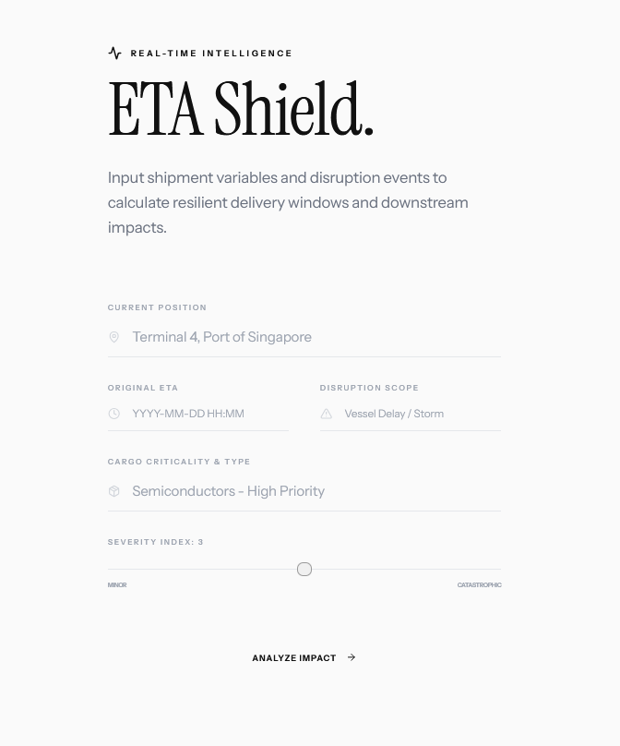
Snapshots of the MVP

Slide 7
Links:
GitHub Public Repository
Working Prototype Link: https://etashield.vercel.app/

Slide 8


